Slide 1
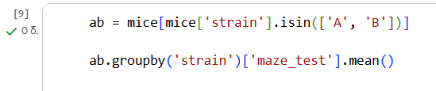
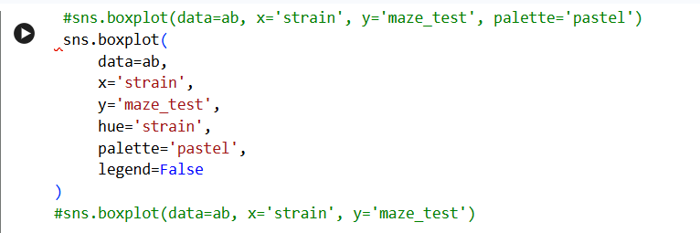
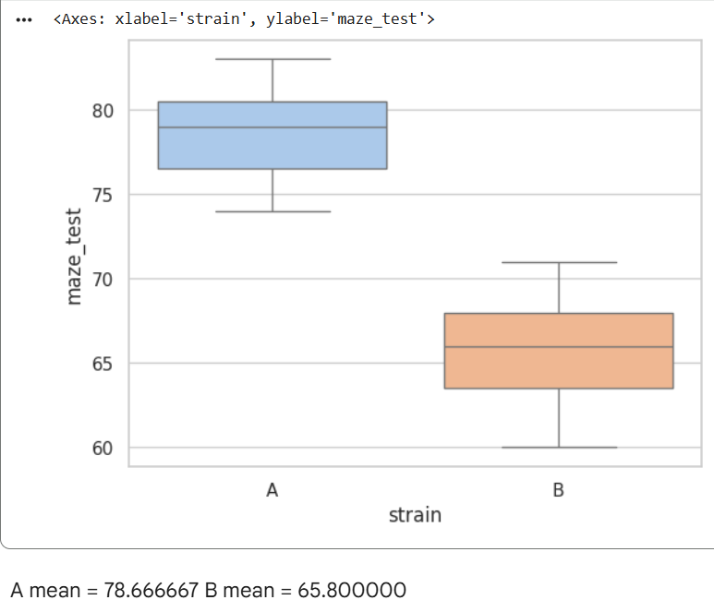
We create a new dataframe ab by filtering the original mice dataset in order to keep only the observations corresponding to strains A and B. This is done using the isin() function on the strain column.
The analytical plan is to compare the mean maze test scores between the two strains. To achieve this, we group the data by strain using the groupby('strain') function and compute the mean maze test score for each group using the .mean() command. This step provides the average maze performance for strain A and strain B, allowing a direct numerical comparison between the two groups.
To visually assess the differences between the two strains, we generate a boxplot using the sns.boxplot() function from the Seaborn library. The boxplot provides a clear representation of the distribution of maze test scores for each strain, including the median, interquartile range, and overall spread of the data.
Different colors are used to distinguish between strains A and B, making the comparison more intuitive. The boxplot shows that strain A has a clearly higher median maze test score than strain B. This observation is consistent with the mean values (mean A = 78.67, mean B = 65.80), and the limited overlap between the interquartile ranges indicates a consistent difference in performance across the two groups.Comments in the code are added using the # symbol and are used to describe each step of the analysis for clarity and reproducibility.

